Slide 1

EE290C Final Project: GPS Receiver
By: Daniel Grubb, Olivia Hsu, Zhaokai Liu, Aviral Pandey, Dinesh Parimi, Ruocheng Wang, Zhongkai Wang, Nick Werblun
Do Not Distribute: Access Restricted to BWRC Members

Slide 2
Outline
Overview
Modulation
Satellites
Receiver structure
Acquisition
Tracking
Ranging
Integration
Conclusion
Next steps

Slide 3
Overview

Slide 4
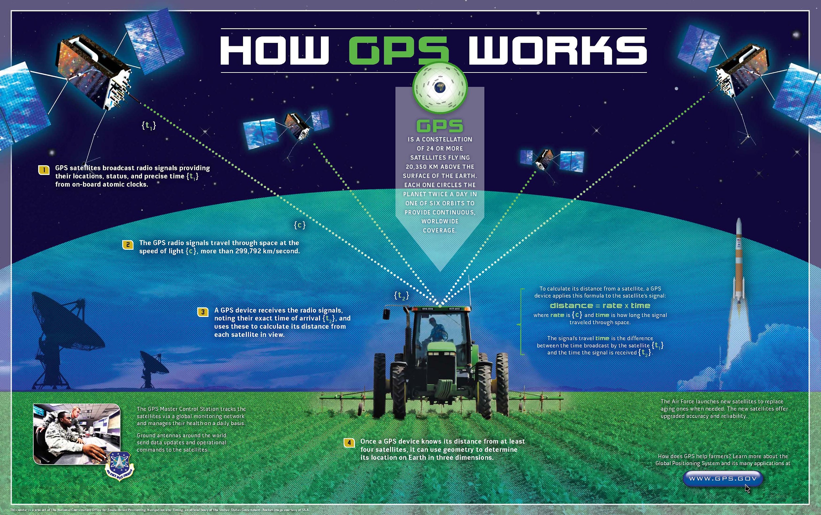
Overview
Source: https://www.af.mil/News/Article-Display/Article/757533/gps-registers-most-accurate-signal-yet/

Slide 5
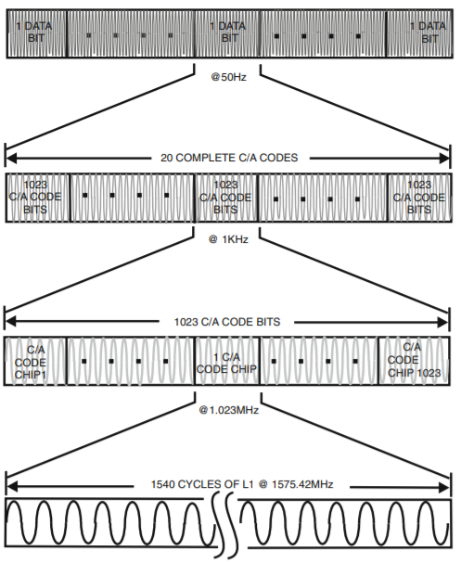
GPS Signals
L1 C/A GPS system
CDMA scheme
1023 length PRN codes
50 Hz data
Info both in message and timing
Doberstein. Fundamentals of GPS Receivers, Springer. 2012.

Slide 6
Acquisition

Slide 7
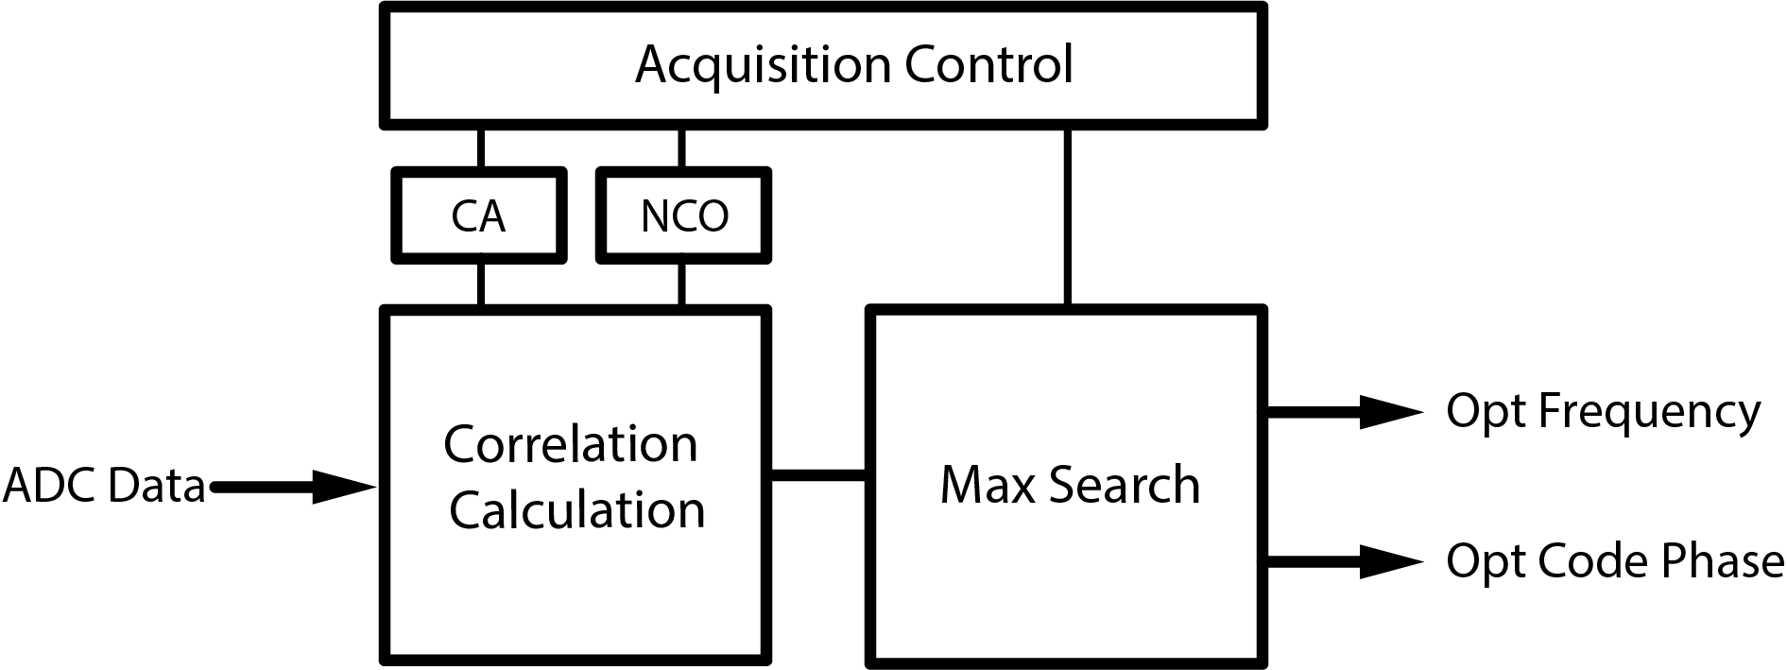
Acquisition: Overview
Tracking loop has limited frequency and code phase range
Need acquisition block to narrow down frequency and code phase
Get correlation for different frequency and code phase
Two methods: FFT and serial correlation calculation

Slide 8
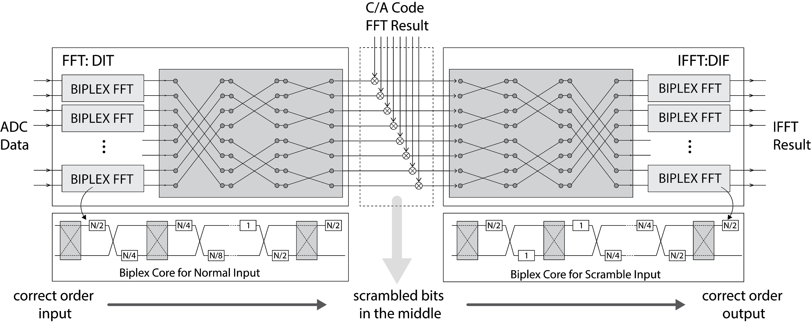
Acquisition: FFT Search

Slide 9
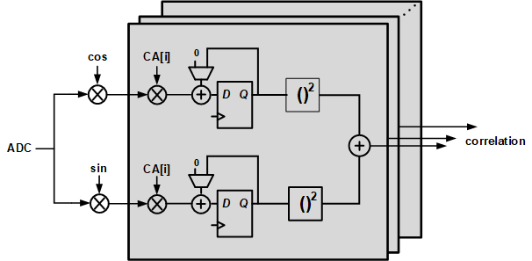
Acquisition: Serial Search
Correlator: correlation of 1 frequency & code phase
Multiple correlators: NCO & ADC signals reuse, acquisition time reduces
parallel code phase search, serial frequency search
Parameterized number of correlators, number of integration cycles, etc.

Slide 10
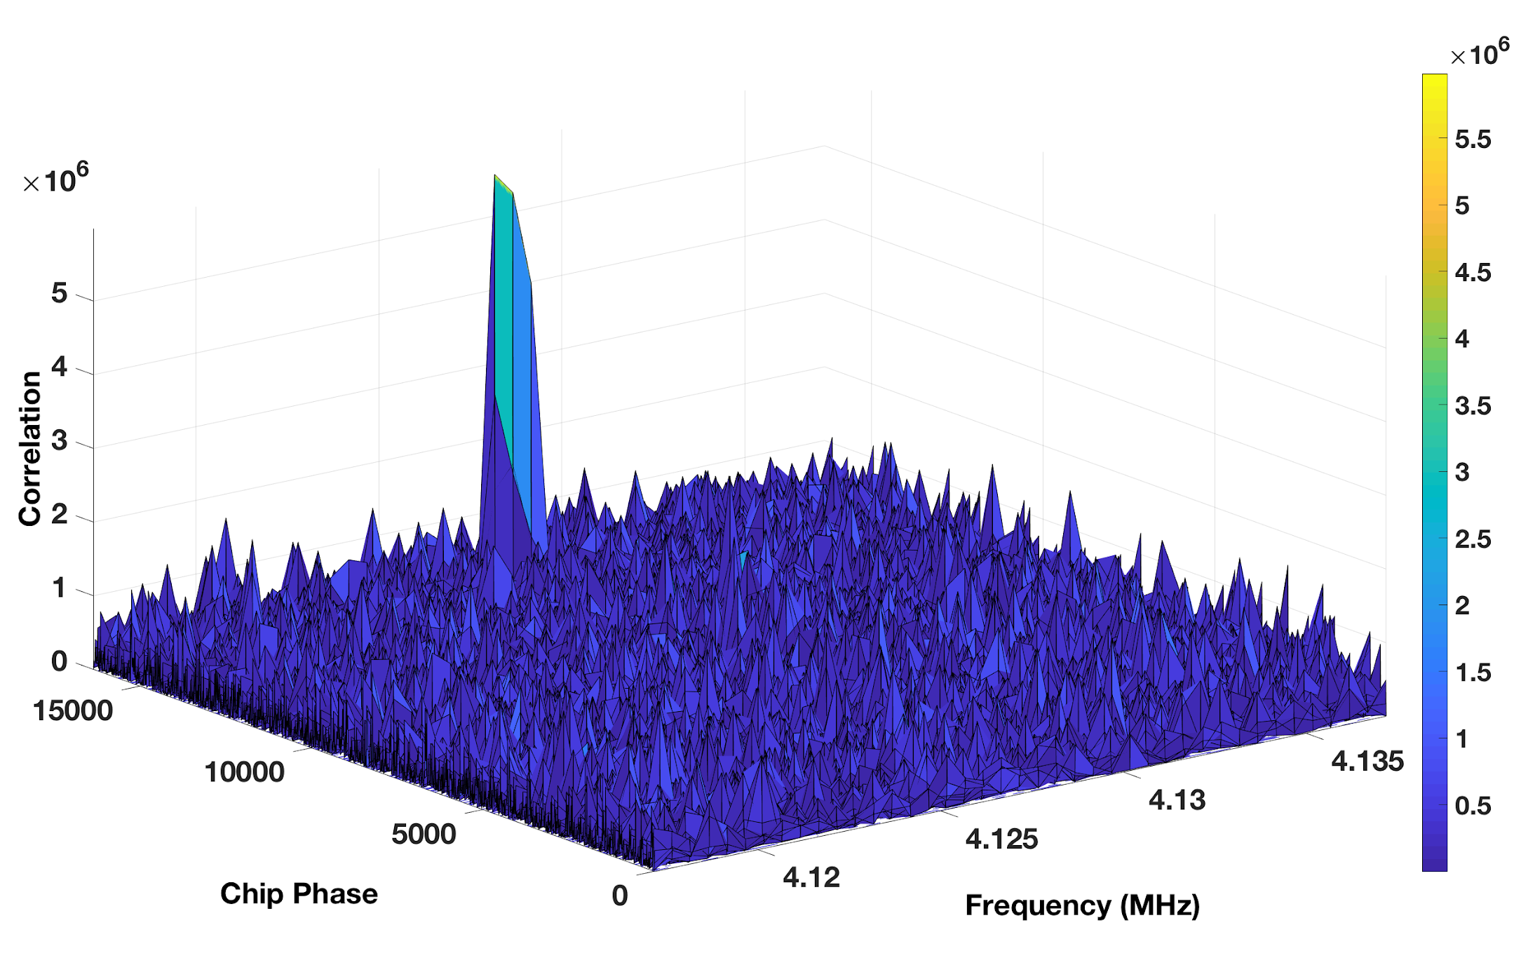
Acquisition: Results and Next Steps
FFT Search takes too much time in compile and simulation, only serial search is verified
With real GPS data, the optimal frequency and code phase is located successfully
Both methods are taking much more area than expected, to be solved in future
Results with 40 frequencies with 500Hz frequency steps and 2046 code phases with 8 code phase step

Slide 11
Tracking

Slide 12
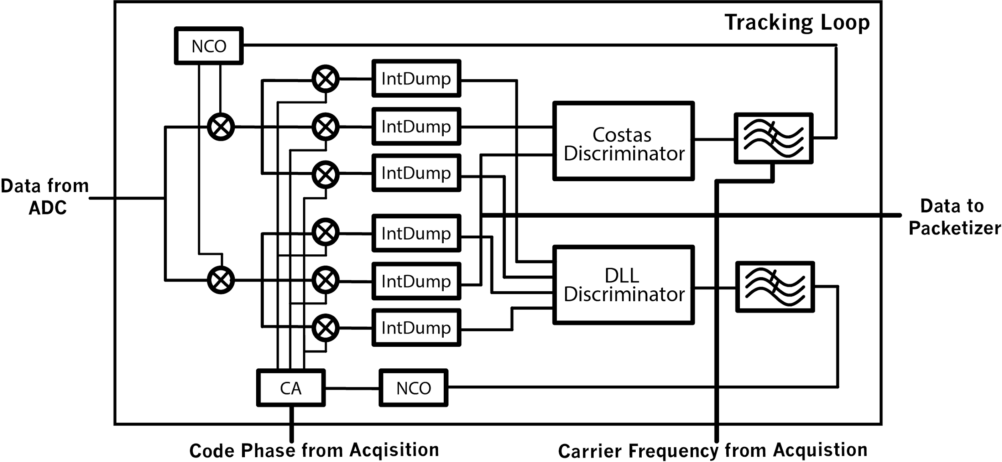
Tracking: System Overview
The tracking loop ensures that the frequency and code phase passed in from the acquisition loop stay locked
The code phase lock is maintained using a delay locked loop (DLL)
The carrier frequency and phase lock using a frequency assisted Costas loop
Each loop has a discriminator that turns the correlator outputs into meaningful data and a loop filter that reduces the noise of the discriminator output

Slide 13
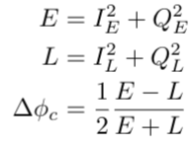
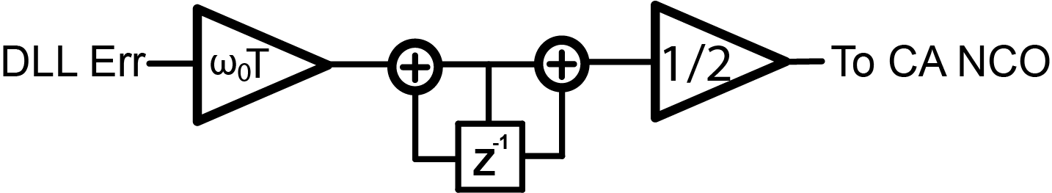
Tracking: Code Recovery
The DLL consists of a discriminator defined by:
Normalized early-minus-Late envelope
Normalization removes amplitude sensitivity
Moderate computational load, no square root calculations
Also has a first order loop filter that drives the two code generator NCOs:
The discrete bilinear transform of a first order analog integrator
Unconditionally stable

Slide 14
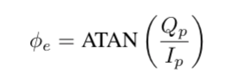
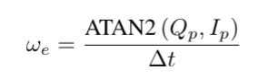
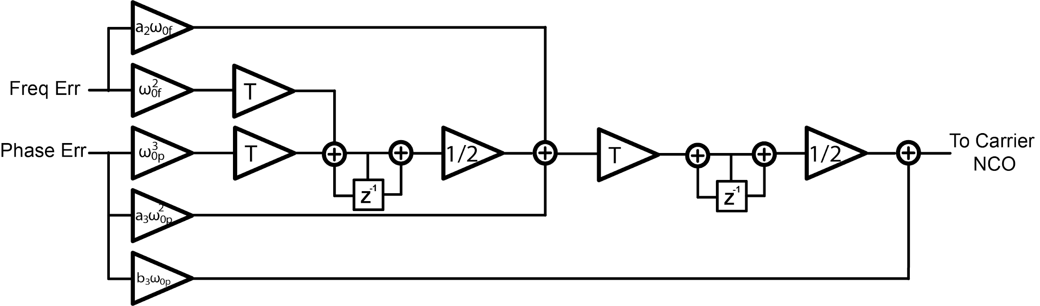
Tracking: Carrier Recovery
The Costas loop consists of two discriminators:
A bit transition invariant Costas discriminator using 2 quadrant arctan
A bit transition sensitive frequency discriminator using 4 quadrant arctan
Added a integrator-based synchronizer to align to bit flips
The two errors are fed into a 3rd/2nd order filter that drives the carrier NCO

Slide 15
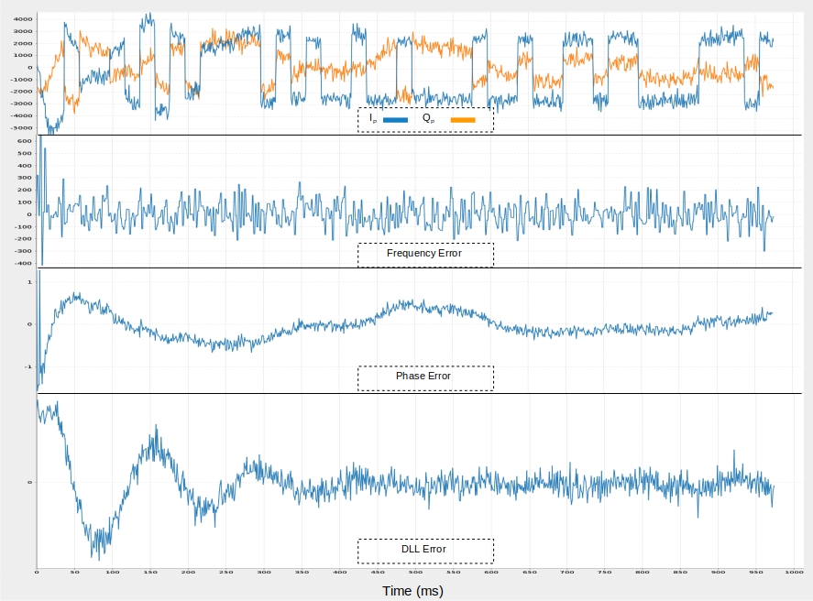
Tracking: Results
Implemented all the RTL, including CORDICs, for discriminators and loop filters
Able to track GPS satellites from the example Dataset in a Scala/RTL mixed simulation

Slide 16
Tracking: Next Steps
Full RTL simulation of Loops does not yet converge due to LSB issues in the CORDICs, need to optimize sizing of Fixed Points
Current design requires 3 Cordics per tracking channel, need to create a system to “timeshare” a single CORDIC block per channel and loop calculation
Loop can only do 1ms integration times, need to allow the loop dynamically to dynamically switch to 2, 5, 10 and 20ms integration times
Implement a lookup table based coefficient setter for the loop-filters

Slide 17
Ranging

Slide 18
Ranging Overview
The ranging code is responsible for the pipeline of hardware decoding to user position. This is the ultimate goal of the GPS receiver.
Ranging is a three step process:
Extract SV parameters and apply scaling/unit conversions
Compute “GPS time” and SV position
Compute user position

Slide 19
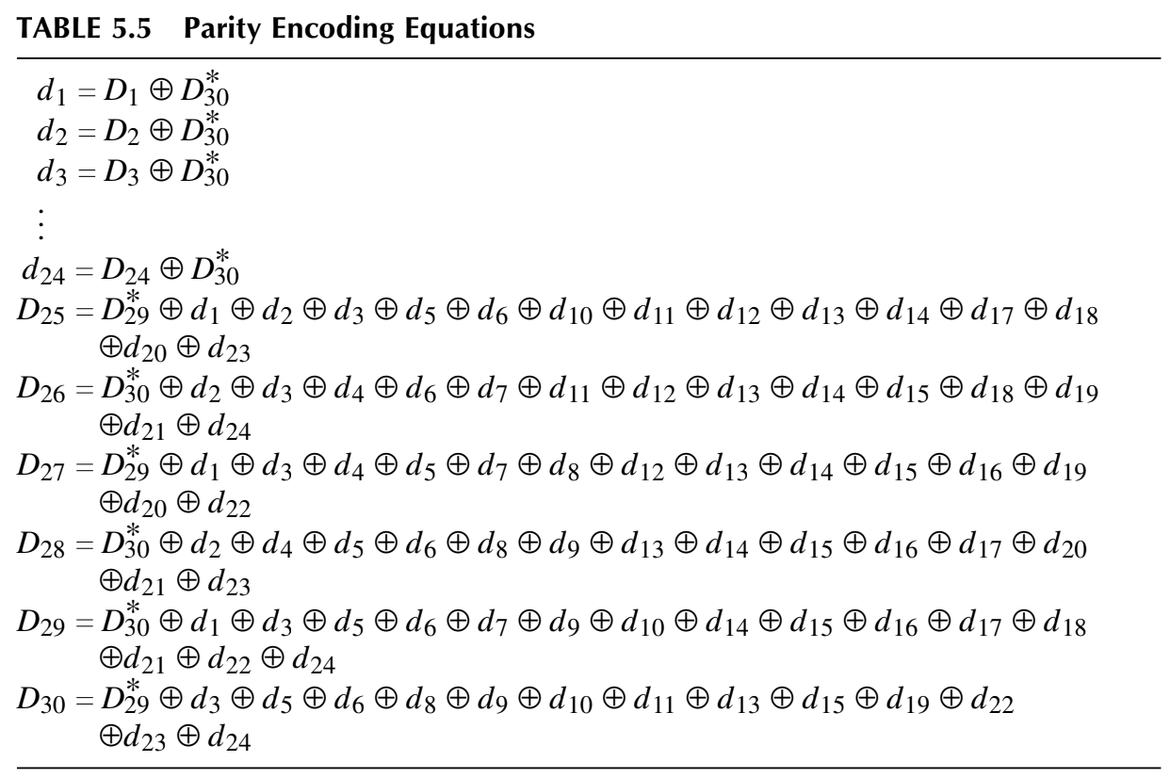
Hardware Extraction - Packetizer
Bit-domain decoding of data
Basic unit of data: 1 word = 30 bits
10 words form a subframe, 5 subframes form a frame
Positioning data found in first 3 subframes
Three submodules in series - parser, parity checker, param extractor
Parity check equations (Fundamentals of Global Positioning System Receivers: A Hardware Approach)

Slide 20
Hardware Extraction - Packetizer (cont.)
Parser
Detects 8-bit GPS preamble that indicates the start of a subframe
Reads 300 bits into a buffer and passes to next stage
Parity checker
Each word has 24 data bits and 6 parity bits
Parity bits are calculated with certain XOR patterns of the 24 data bits and the 2 last bits of the previous word
Parity check must pass on all words of a subframe for data to be valid
Param extractor
Identifies subframe and extracts relevant parameters for ranging algorithm
This submodule was added later, as the bit manipulations it requires were inefficient in software

Slide 21
Hardware Extraction - Packetizer (cont.)
Firmware-hardware interfacing done through a regmap
Read UInts/SInts from Chisel, convert data types and apply scaling in hardware
Package as a struct to be passed to ranging algorithm
Different memory block per tracking channel

Slide 22
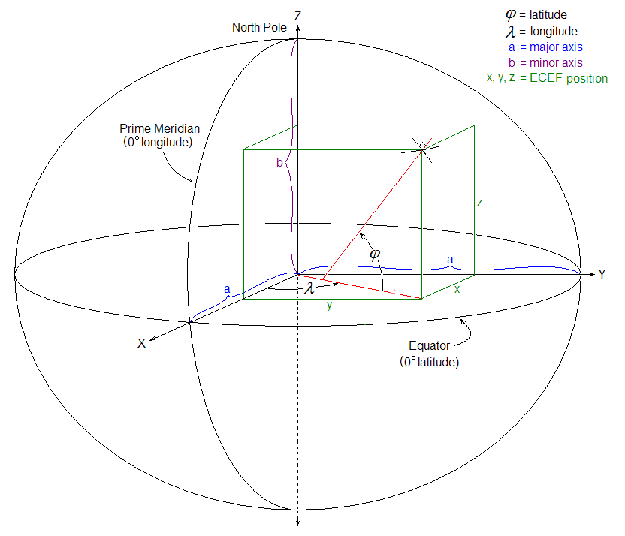
SV Position Calculation
“GPS time” is a local replica of the SV clock
SV ephemeris data contains info necessary to compute this time delay
SV Position is computed using an established set of equations that include correction for motion and other non-idealities
ECEF (Earth-Centered, Earth-Fixed) Coordinates
Image source: https://en.wikipedia.org/wiki/ECEF

Slide 23
SV Position Calculation (Cont.)
After parameter extraction, local replica clock is created and SV position is computed
These results are stored in a struct
After four sets of SV data are populated, they are sent to the user position calculation

Slide 24
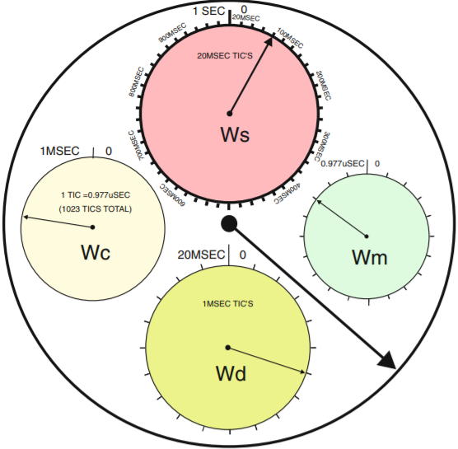
Receiver Position Calculation
Inputs:
4 SV Positions
Signal transmit and receive times
Outputs:
Receiver position
Receiver time bias
Tracking loop is a model of the SV signal at transmit
Pseudorange
Iterative calculation
Doberstein. Fundamentals of GPS Receivers, Springer. 2012.

Slide 25
Ranging Conclusion and Next Steps
The skeleton for computation is complete, but is not fully integrated with hardware due to incomplete datapath
Using decoded data from jks.com/gps/gps.html we were able to verify that the SV position calculation is correct
Decoding parameters and recording times from tracking loop measurements
BWRC Location (km):
X: -2641.466
Y: -4262.826
Z: 3894.033

Slide 26
Integration

Slide 27
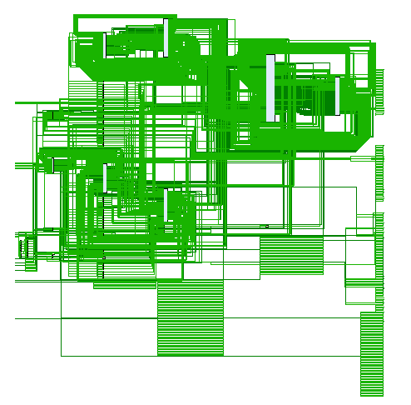
Integration: Results and Next Steps
The tracking channel has been connected to Rocket using a register mapped approach
Next Steps:
The next integration component is to connect the acquisition loop with the tracking loop
The current plan is to connect the two using RocketChip
Cannot be done until after the acquisition area has been optimized
Ranging code also needs to be tested with the tracking loop hardware and Rocket

Slide 28
Conclusion

Slide 29
Conclusion
CHISEL was a great tool
Able to generate variants on submodules - reusability!
Scala was conducive to test automation
Ability to straightforwardly integrate software/hardware
Top-level integration workflow was very different from other HDLs - took some getting used to
DspTools is critical for CHISEL DSP applications
FixedPoint!
Connecting with RocketChip gives instant ability to test system as an SoC

Slide 30
Documentation

Slide 31
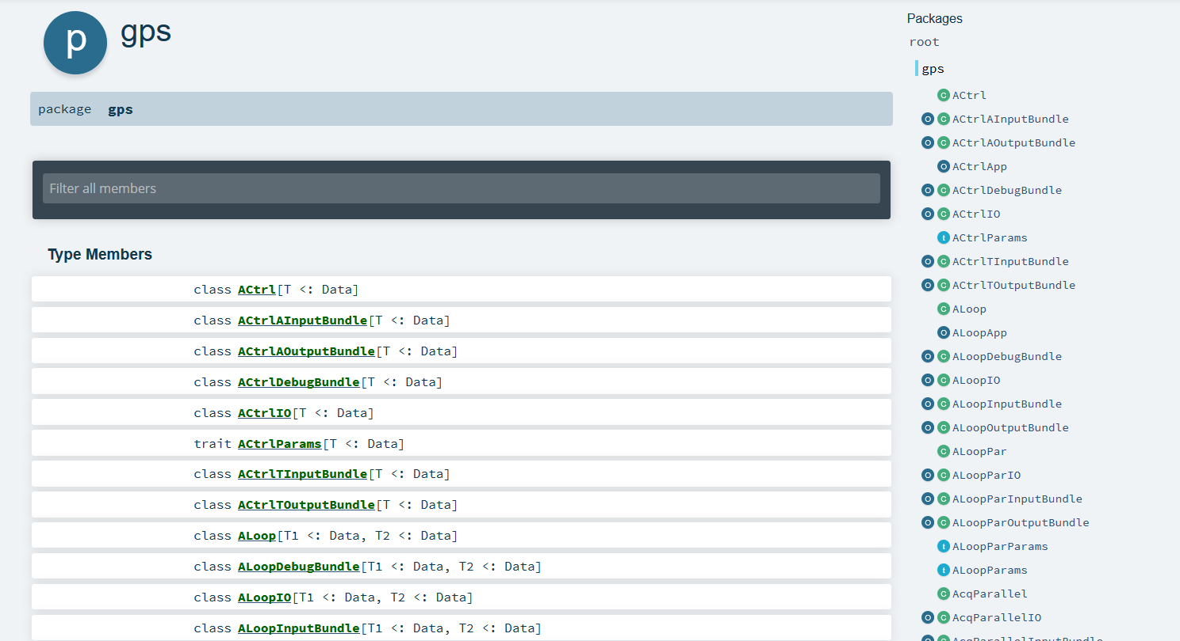
Scala Docs

Slide 32
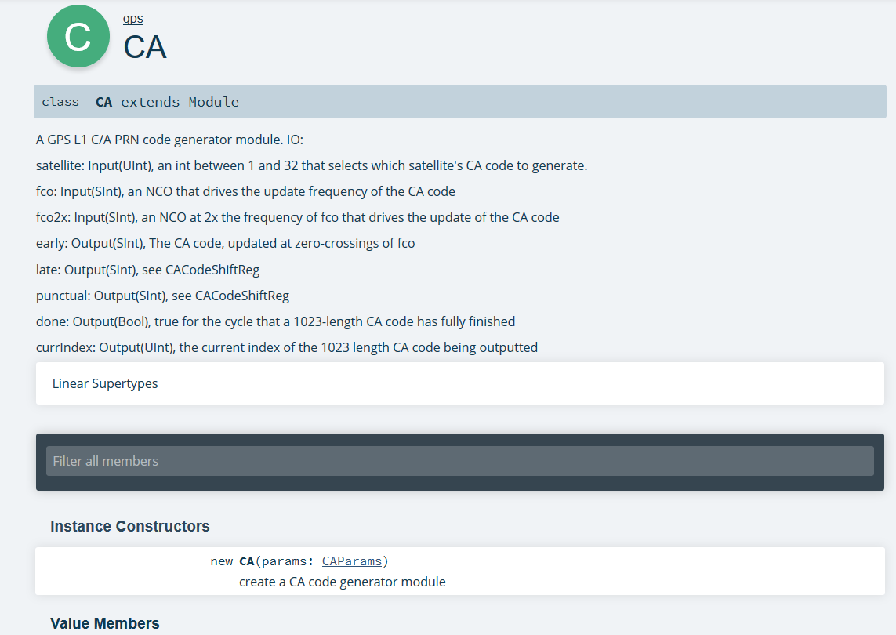
Scala Docs

